Slide 1
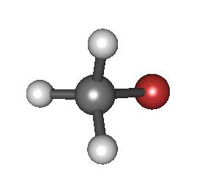
INFRA RED ABSORPTION SPECTROSCOPY

Slide 2
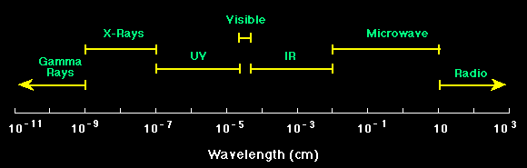
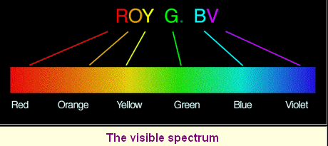
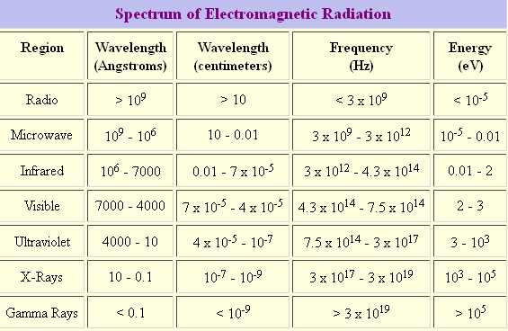

Slide 3




Energy Levels
Basic Global Warming: The C02 dance …
About 15 micron radiation

Slide 4
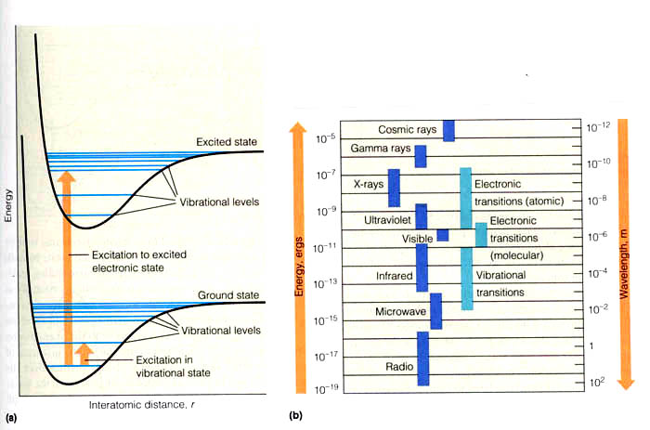

Slide 5
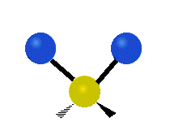
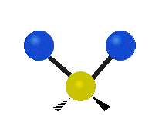



Infrared spectroscopy
(IR spectroscopy) is the spectroscopy that deals with the infrared region of the electromagnetic spectrum, that is light with a longer wave length and lower frequency than visible light
Infrared spectroscopy exploits the fact that molecules absorb specific frequencies that are characteristic of their structure . These absorptions are resonant frequencies, i.e. the frequency of the absorbed radiation matches the transition energy of the bond or group that vibrates. The energies are determined by the shape of the molecular potential energy surfaces , the masses of the atoms, and the associated vibronic coupling
Symmetric stretching | Asymmetric stretching | Scissoring
Rocking | Wagging | Twisting

Slide 6
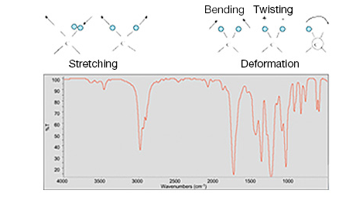
The infrared spectrum for a molecule is a graphical display
The spectrum has two regions:
The fingerprint region 600-1200 cm⁻¹
Functional group region 1200-3600 cm⁻¹

Slide 7
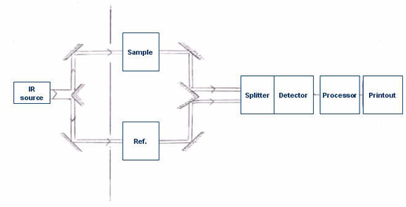
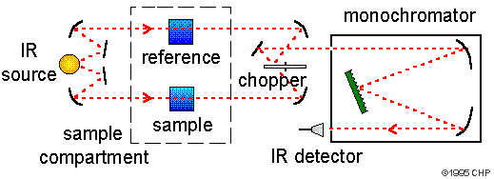
block diagram of a classic dispersive IR spectrometer

Slide 8
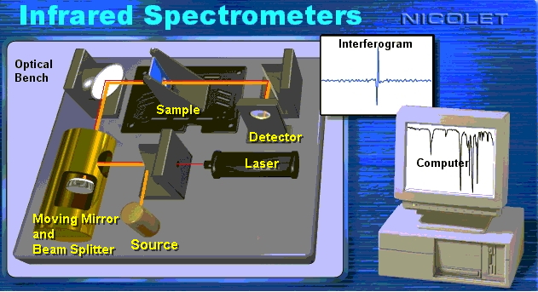
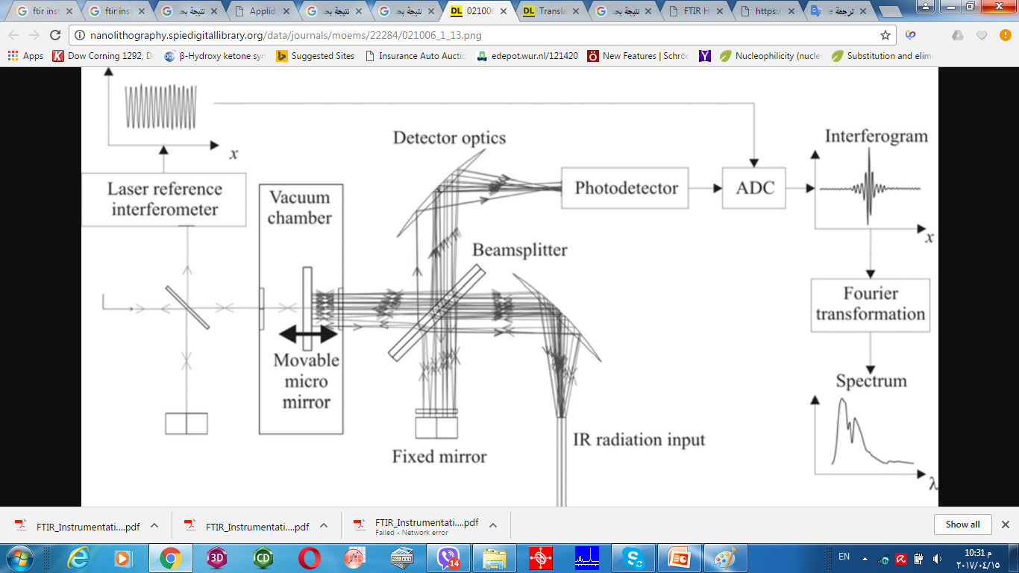

Slide 9
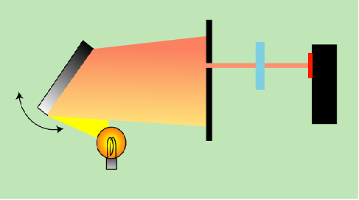
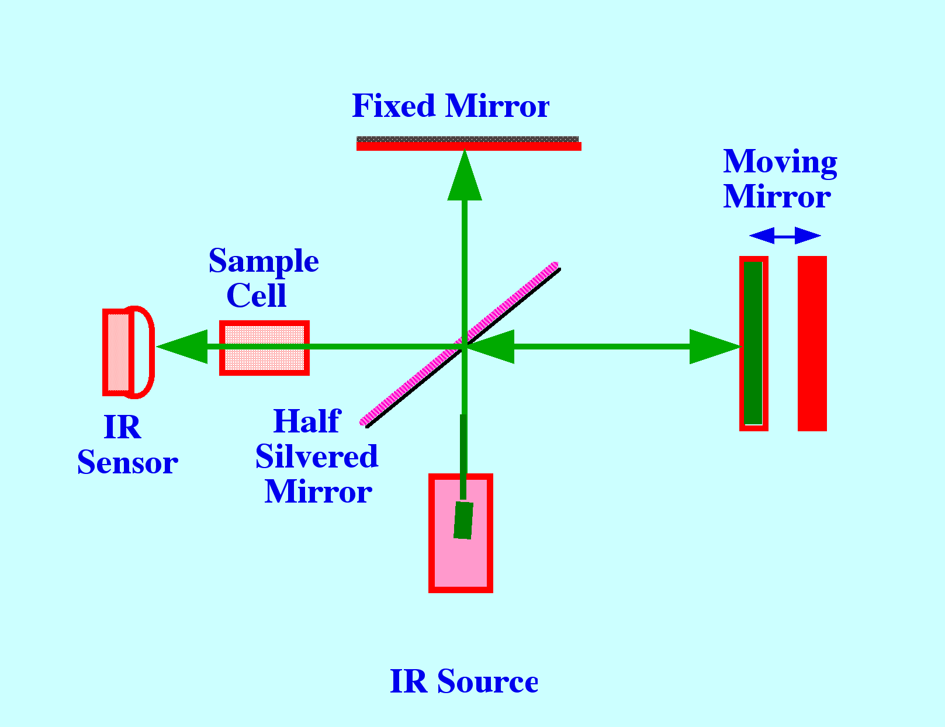
Two types of instrumentations are used to obtain IR spectrum;
        Dispersive Type
        Fourier Transform Infrared (FTIR)
Having a filter or grating monochromator

Slide 10
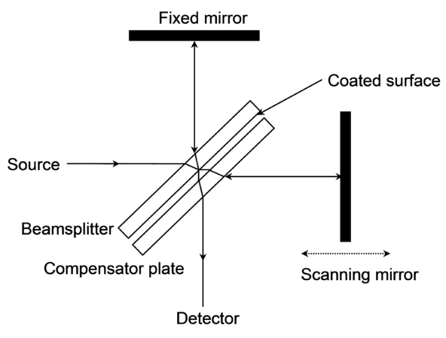
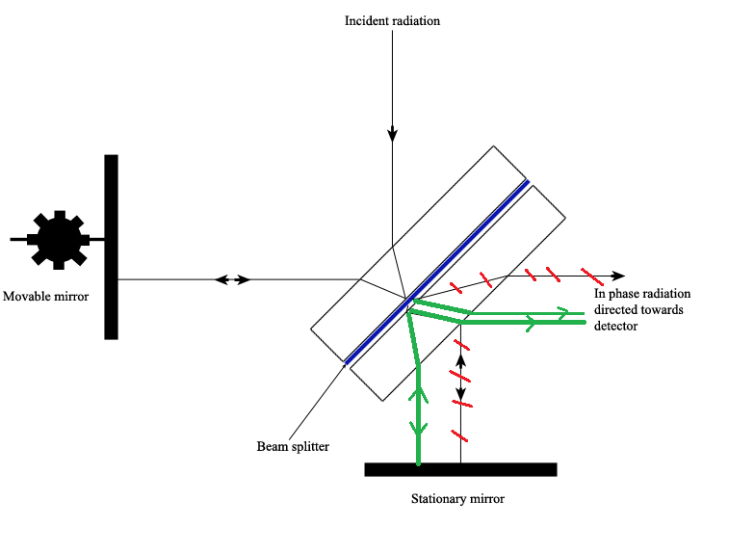
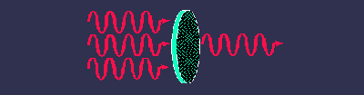
Michelson Interferometer
The Michelson interferometer, which is the core of FTIR spectrometers, is used to split one beam of light into two so that the paths of the two beams are different. Then the Michelson interferometer recombines the two beams and conducts them into the detector where the difference of the intensity of these two beams are measured as a function of the difference of the paths.
schematic of the Michelson Interferometer.

Slide 11
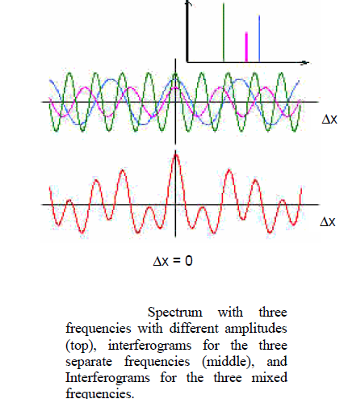

Slide 12
Applications of FT-IR
Pharmaceutical research
Forensic investigations
Polymer analysis
Lubricant formulation and fuel additives
Foods research
Quality assurance and control
Environmental and water quality analysis methods
Biochemical and biomedical research
coatings and surfactants

Slide 13
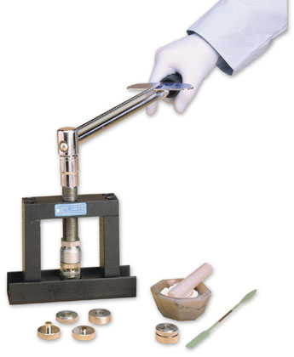
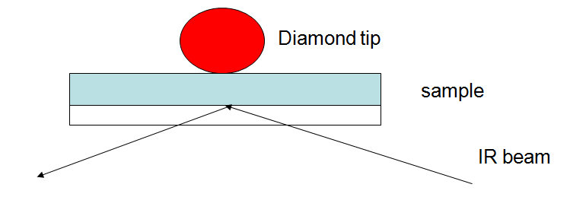
Sample Preparation
Gaseous samples
Long pathlength to compensate for the
diluteness
Liquid samples
Can be sandwiched between two plates of a salt
  sodium chloride
  potassium bromide
  calcium fluoride
Solids
  KBr pellet
  Nujol mull
  Dissolving in organic solvent(CCl₄)
ATR

Slide 14
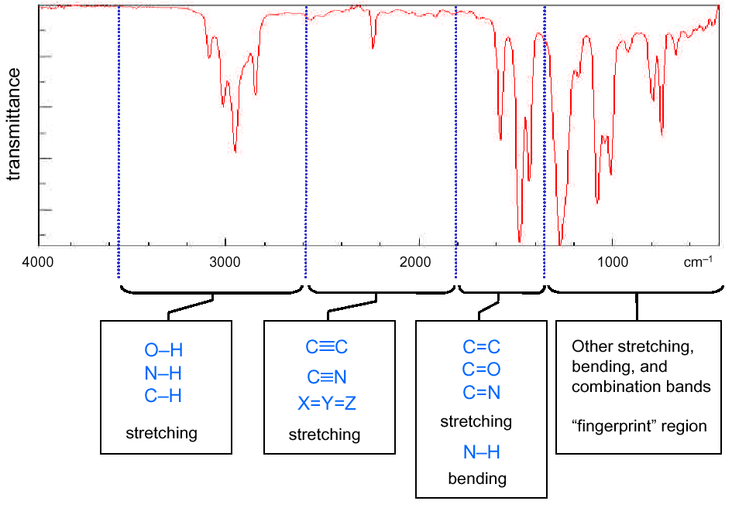
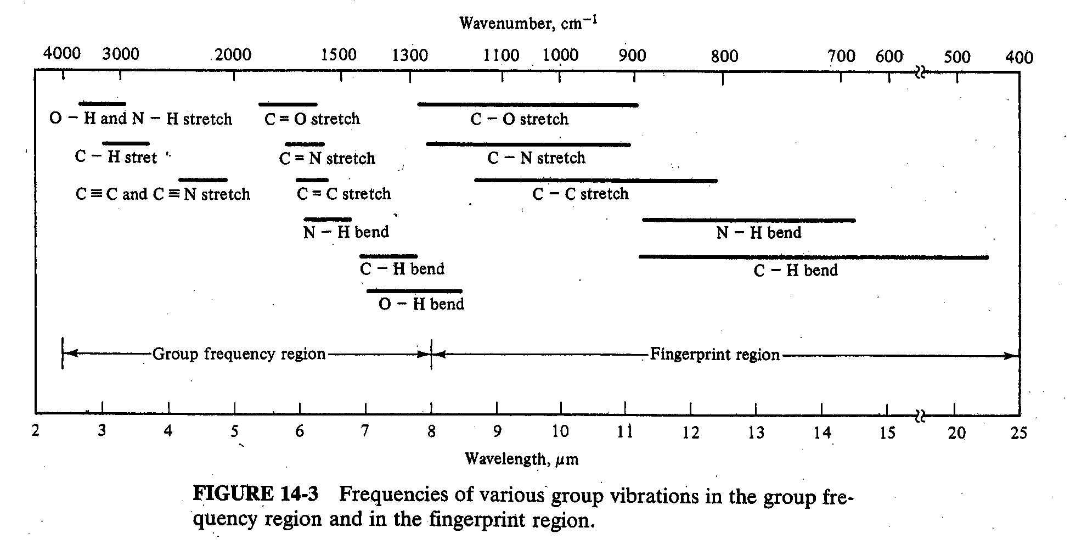

Slide 15
Infrared Spectrum of Hexane
bending
C—H stretching
bending
bending
CH₃CH₂CH₂CH₂CH₂CH₃
3500
3000
2500
2000
1500
1000
500
Wave number, cm⁻¹

Slide 16
Infrared Spectrum of 1-Hexene
C=C
C=C—H
H—C
H₂C=C
H₂C=CHCH₂CH₂CH₂CH₃
3500
3000
2500
2000
1500
1000
500
Wave number, cm⁻¹

Slide 17
Structural unit Frequency, cm⁻¹
Stretching vibrations (single bonds)
sp C—H 3310-3320
sp² C—H 3000-3100
sp³ C—H 2850-2950
sp² C—O 1200
sp³ C—O 1025-1200
Structural unit Frequency, cm⁻¹
Stretching vibrations (multiple bonds)
C
C
1620-1680
—C
C—
2100-2200
—C
N
2240-2280

